Slide 1

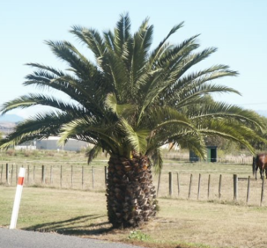
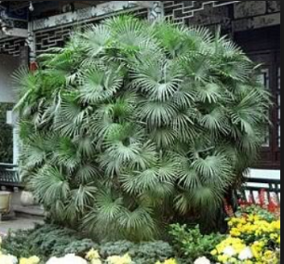
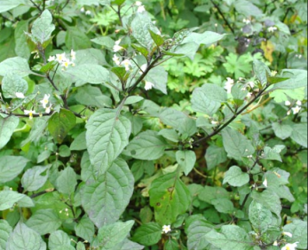
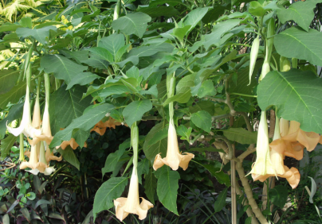
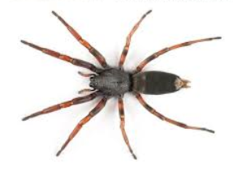
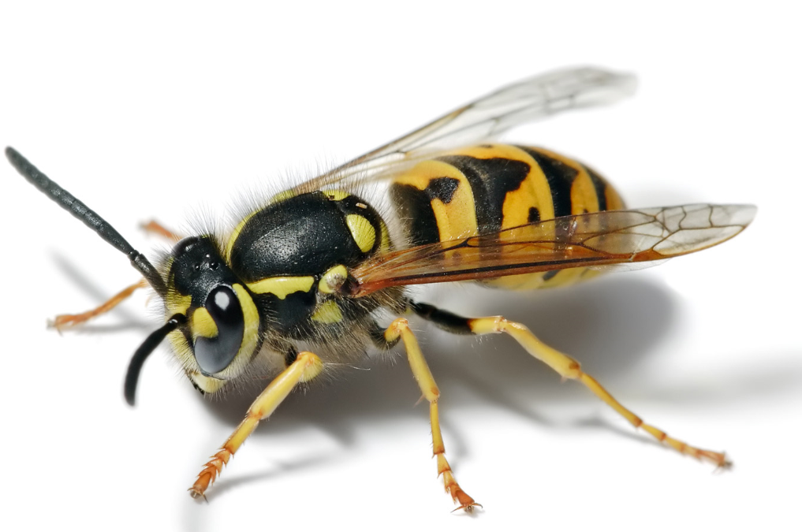
SAFETY ALERT
HAZARDOUS PLANTS & INSECTS
Recently one of our service personnel had a Phoenix palm spike embedded in his finger while working on a meter box at a customer’s premises. This resulted in two trips to the A&E to have the spike removed and swelling and pain over many days.
There are many plants and some insects which can cause serious harm to personnel working in the natural environment, including:
Phoenix Palm Finger Palm Nightshade Trumpet candida White tail spider Wasps
Pinch point
Before starting work:
Assess your surroundings to identify potential risks including plants, insects and animals.
Cover up including, safety glasses, gloves, long sleeves and pants.
Select the right tools to manage the risk. Use tools instead of hands to handle hazardous plants.
If you suffer from plant or insect allergic reactions seek your GP’s advice for an emergency plan.
Notify your supervisor of any allergies that may be impacted by your work.
STOP WORK is you think the environment is unsafe to work in. Notify your supervisor.
Injury response
Wash the affected area immediately with clean water.
Cover cuts with sterile dressings or plasters to prevent bacterial infections.
Seek medical attention immediately for thorns or spikes embedded in the skin, spider bites, eye scratches and any serious plant, insect or animal related injury.
Notify your manager or supervisor of any injury and report in Synergi.
Monitor the injury for delayed reaction or infection. Seek medical attention immediately.
Landing leg being pushed back into locked position and contact with limit switch.
Landing leg extended
27 July 2017

